Slide 1

By: Team Alexa

Slide 2
GOAL
As the second line of defence, moving away from
being REACTIVE to becoming PROACTIVE

Slide 3


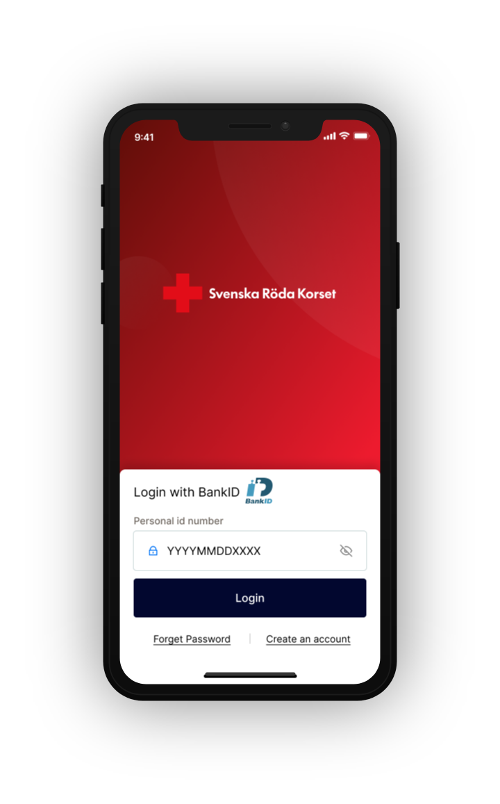

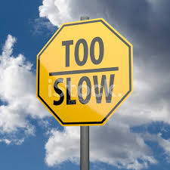



TABLE OF CONTENTS
01
02
03
04
CURRENT MEASURES
PROBLEM
OUR SOLUTION
FUTURE
1. What does RC want?
2. Current solution for them
1. Pain points
1. An app for RC
2. Run-through of functions
3. How does RC get critical news faster
1. Collaboration with governmental authorities
2. The team
Notes:
Put the app picture here

Slide 4

JOB TO DO FOR RC
Compile information from numerous sources and visualize and find patterns in order to make better decisions.
Second line of defence for disasters and events requiring humanitarian aid

Slide 5
CURRENT SOLUTION
“Officers on duty” manually scan Omni.se, TT, Google and Aftonbladet for news on crisis happening
Wait for the police/fire department to contact them and ask for help
Plan for mission and send out information to volunteers through WhatsApp groups

Slide 6

PAIN POINTS
SPEED
RELIABILITY
REACTIVE APPROACH
It is manual and time consuming for the officer in charge to look through all news agencies
The news that is picked up by the officer might contain ‘fake news’
By looking for news, RC is simply reacting to what is happening instead of preparing before hand

Slide 7

SOLUTION: SWEDISH RED CROSS APP
Focus on having updated news/media on one platform for RC “Officer on site” through data scraping
Involving volunteers/public users to provide real time update on the live situation
Notes:
Swedish Red Cross app is also a means by which members of the public may be asked to provide onsite information (via submission of photos/video) for Red Cross to gain a better understanding of the situation
Moving away from reactive to proactive
Briefly describe what the app is for, Red Cross and the users,
Slide on user profile
Functions of the app to be showed on demo,
Key focus is for real time update of situations happening via real people.
Data scrapping using open source API as well to show events or threads happening around

Slide 8
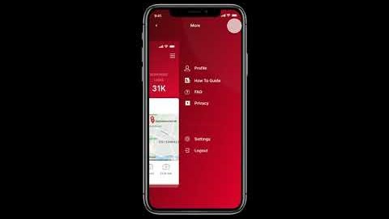

Slide 9

THE FUTURE
Automated Geo-tagging when a case is reported via the app
Work with Governmental Organisations
Using AI/Machine Learning Tools to better manage news received through scraping process
Channel for RC volunteers to receive instructions from HQ

Slide 10
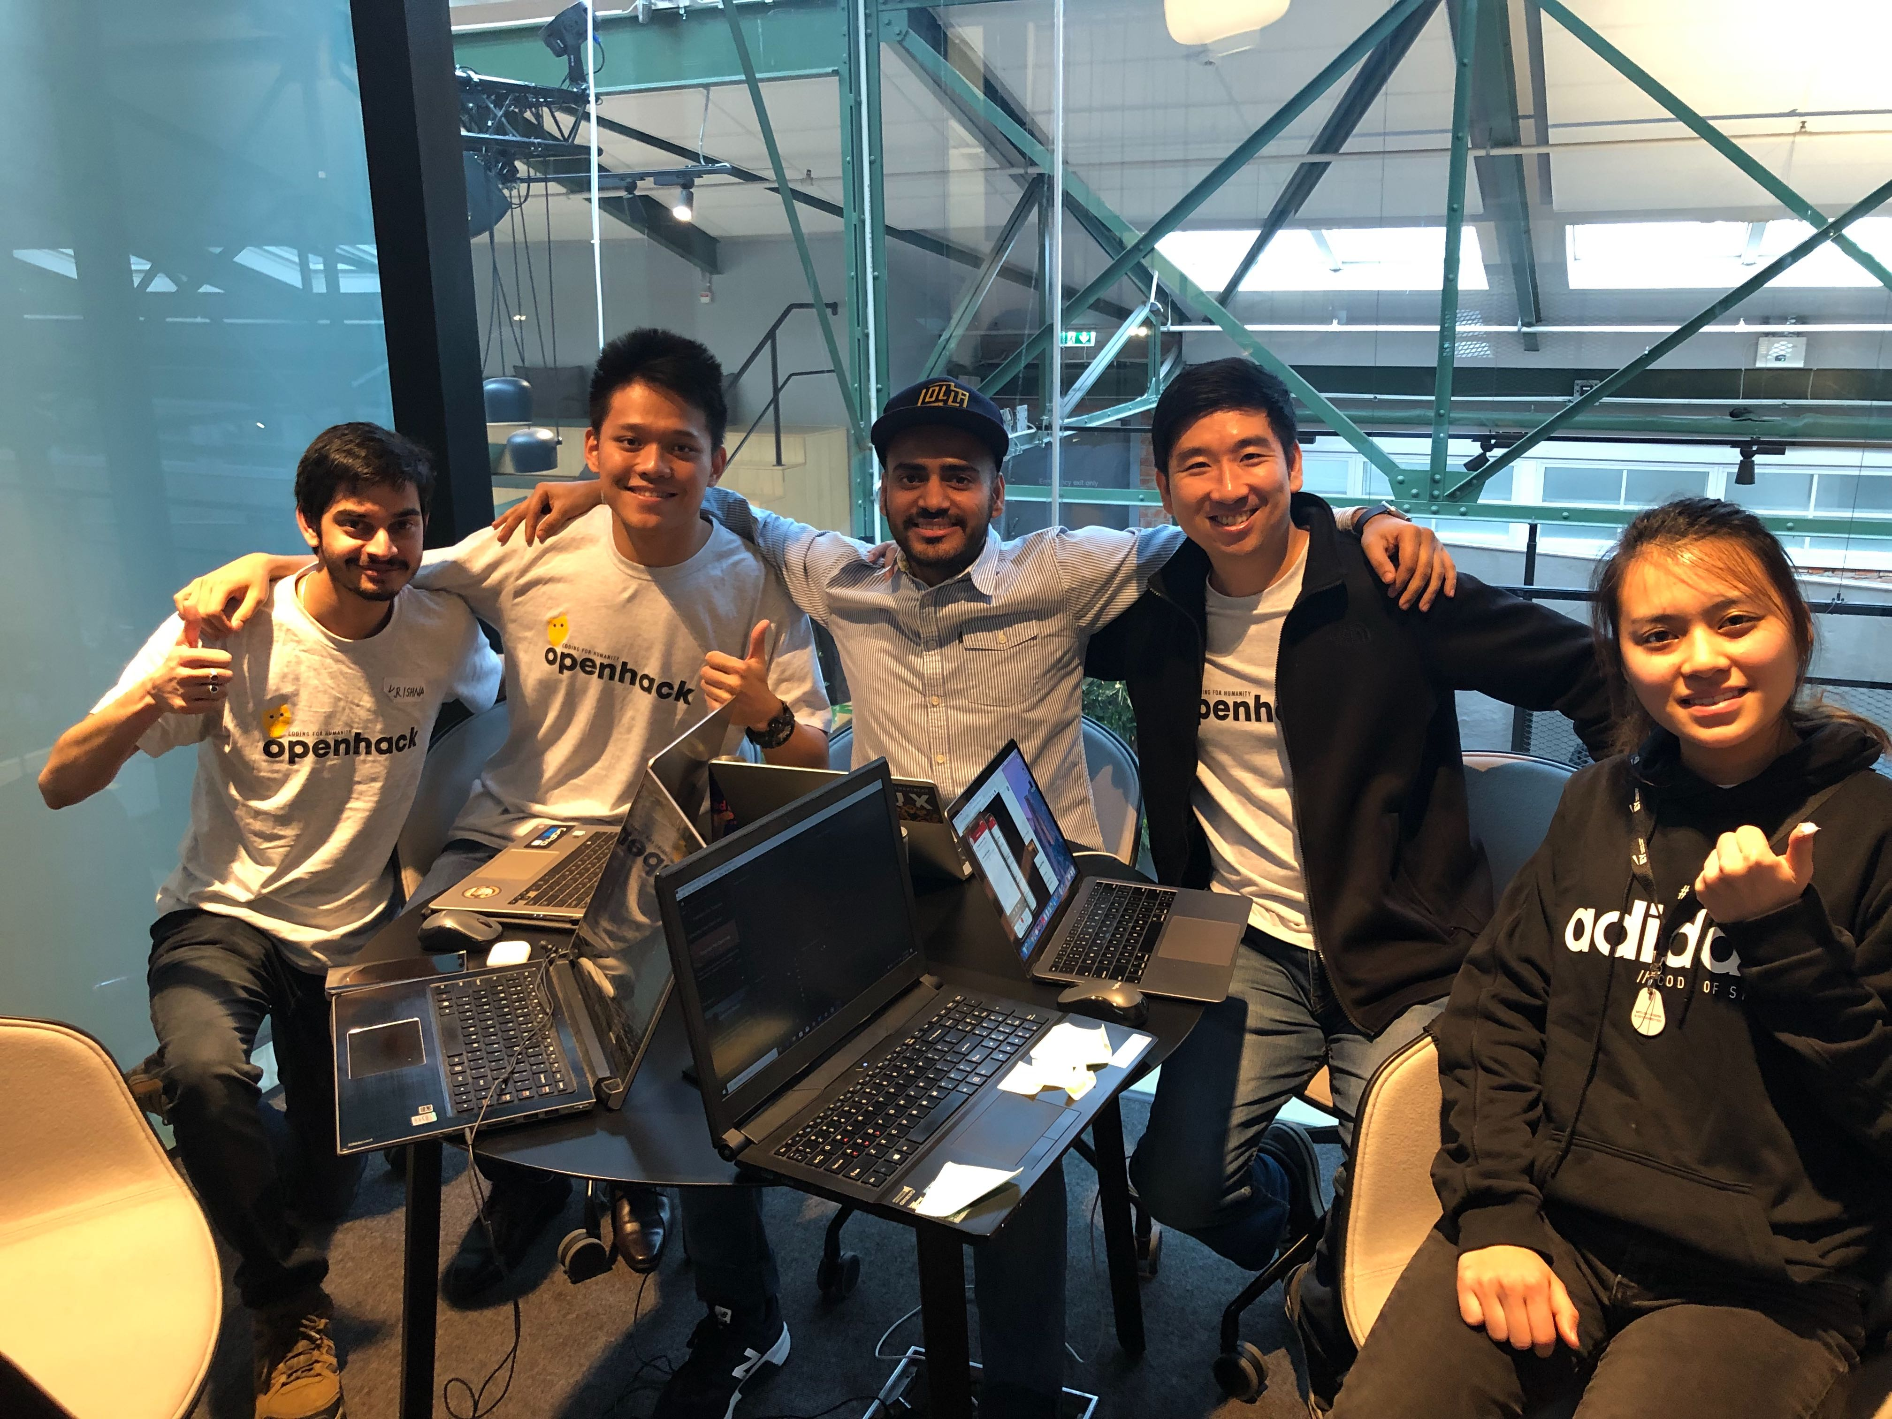
TEAM
Team Alexa

Slide 11

CONCLUSIONS
THANKS!
Does anyone have any questions?
Notes:
In conclusion, We are aligning ourselves with the UN sustainability goal 17 by involving the collaboration between the public, volunteers and other organisations in aim to improve the speed that humanitarian aid reaches the hands of those who need it most!

